Slide 1
Ordering and Delivery Tracker App for Quadro King Water Station Retail Store
Marlo, Dael
Alegrid, Floren Joseph A.
Belbis, Luis Gabriel O.

Slide 2
Definition of Terms
Global Positioning System (GPS) – GPS, which stands for Global Positioning System, is a radio navigation system that allows land, sea, and airborne users to determine their exact location, velocity, and time 24 hours a day, in all weather conditions, anywhere in the world.
Mobile Application – A mobile application, also referred to as a mobile app or simply an app, is a computer program or software application designed to run on a mobile device such as a phone, tablet, or watch.
Android – Android is a mobile operating system based on a modified version of the Linux kernel and other open source software, designed primarily for touchscreen mobile devices such as smartphones and tablets.
Firebase – Firebase is a platform developed by Google for creating mobile and web applications. It was originally an independent company founded in 2011. In 2014, Google acquired the platform and it is now their flagship offering for app development.

Slide 3
Project context
The proponents will be making a delivery tracking app for water stations.
The application will use Global Positioning System (GPS) to track the delivery drivers and the address of the customers.
Instead of calling, texting and or coming to the store directly the customers will only need to use the application to order.

Slide 4
Purpose and description
Most customers doesn’t need to go out of their way to go to stores or malls even to buy products they want, most of them just check mobile app for price and reviews on the product they want and order online.
This also helps on lowering the risk of customers getting infected due to going outside.
Provides tracking and ordering system that does not disregard on customers security aspects.

Slide 5
Objectives
To provide ease in ordering drinking water without the customer having to drive down to the shop to order water.
To provide the Delivery Person a In-app Map Navigation of the customers exact location and to provide efficient routes.
To know the advantages of having this app in Water refilling business with the new and improved monitoring and online transactions.
To lessen the paper works in the environment by using the app as the monitoring peripheral.

Slide 6
Significance of the study
Customers – once they already have an account for the delivery application, it will only take them a few clicks to have their orders placed, their address is already saved and once the moderator of the application confirms the order, they will proceed to prepare and deliver the order.
Owners – Owners of different water station businesses will also be able to use this application to improve their businesses. It will improve the way of transacting with customers.

Slide 7
Significance of the study
The Proponents - this application will be a stepping stone for the start of their IT careers. The aim for this research is not just to innovate the water delivery service, but also to showcase their skills and to learn from different people, and the opinions of others.

Slide 8
Limitation of the study
Due to time constraints the app will not be able to feature online transaction using credit/debit card options for time being since the current system of acquiring API for an Android system may take a few months before the other banks who have technologies to accept payment online.
Limited on specific areas such as: Pilar Village, Almanza Uno, and TS Cruz village which are all located in Las Piñas City.
The application will only be available on android running the version Kitkat or higher.

Slide 9
Review of related literature
Literature
Global Positioning System – The global positioning system is widely used this day and its commonly integrated to modern devises. GPS instruments are now widely used to monitor ground movements during major earthquakes. Access to real-time GPS data sources has contributed to stronger forecasts for tsunamis, flash flooding, earthquakes and volcanic eruptions. Terrestrial water storage shifts can be extracted from GPS vertical time series coordinates. Finally, GPS signals reflected on the surfaces below the GPS antenna can be used to measure soil moisture, snow deposition, vegetation water quality and water levels.

Slide 10
Review of related literature
Study
As the Coronavirus spreads pressures the nation to take protective action, our economy is heavily influenced by the constraints on these recently imposed laws, such as Neighborhood Lockdowns, Social Distancing and Obligatory Curfews according to Francia (2020) on his post on the site benfrancia.com entitled, Logistics and Delivery Service for Small Business Ecommerce. Ports, main roads and numerous trade institutions throughout the country are forced to close or seize activities to avoid the transmission of the pandemic. As a result, company owners have seen a sharp decrease in sales due to the reduced logistic activity that is vital to most business activities.

Slide 11
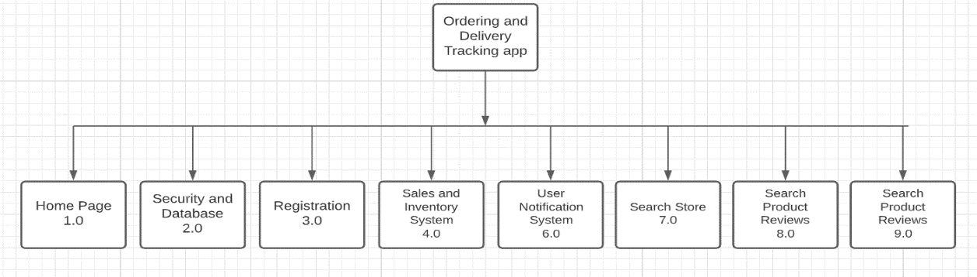
Software Design, Products and/or Processes
The app is composed of several components that would build the entire system. Each of the user has each of the following of modules. Home Page, Security and Database, Registration, Sales and Inventory System (Store Owner), User Notification System, Search Engines and Full administrator tools. On the Figure above listed all the components for the customer’s app.
Figure 3.1 HIPO of the App

Slide 12
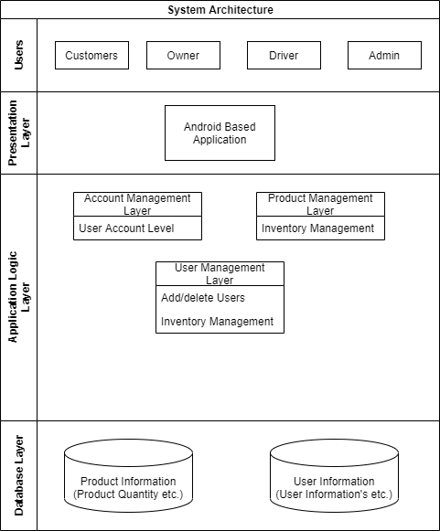
System Architecture
The users will be using android based application to their phones that can be connected through the internet.
Figure 3.3 System Architecture of the System

Slide 13
Conceptual framework
INPUT
Information & knowledge requirements
Software Requirements
Hardware Requirements
INPUT
OUTPUT
Figure 3.5 Conceptual Design

Slide 14
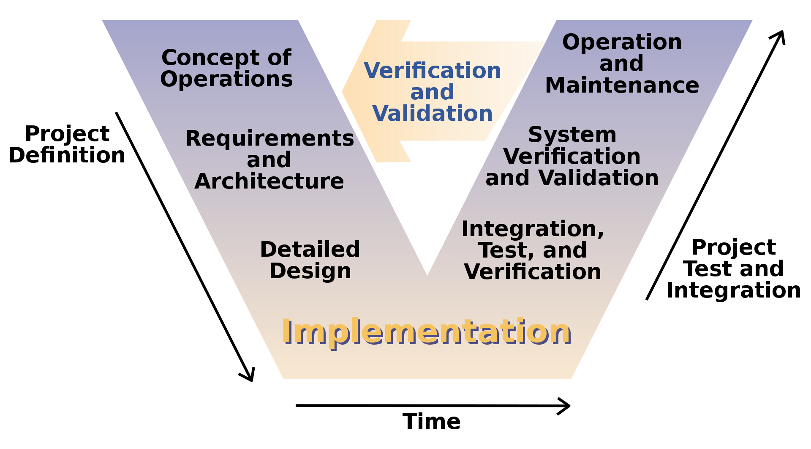
Conceptual framework
V-Model
Figure 3.6 V-Model

Slide 15
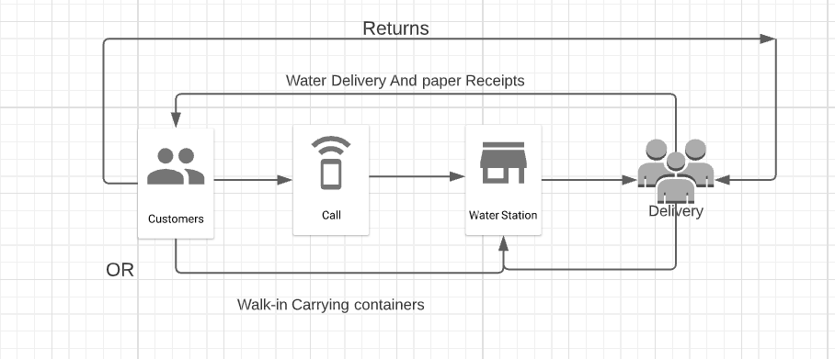
Requirements analysis
The system involves the consumers (customer who orders water), (Drinking Water Refilling Stations), Delivery Personnel (Rider/ The one who take the product to the customer’s location).
Figure 3.7 Current Water Ordering System

Slide 16
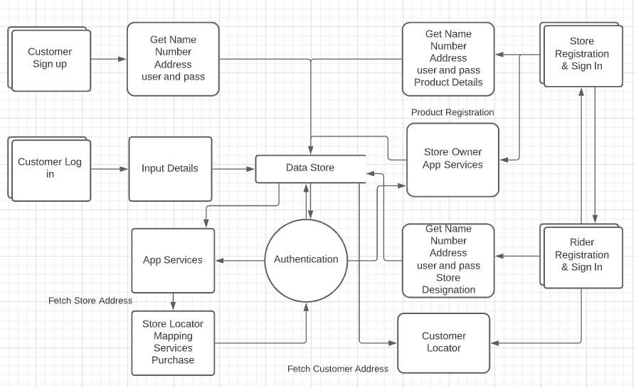
Requirements analysis
Data flow diagram
Figure 3.8 Dataflow Diagram of the proposed system

